Slide 1
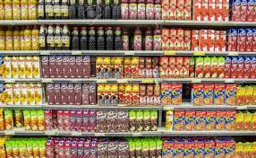
Market Analysis and Strategy

Slide 2

Agenda
Marketing Analysis & Strategic Planning
  Essential Elements (5Cs, STP, 4Ps)
  Situation Analysis / Strategy / Marketing Mix

Slide 3
Marketing Strategy
Involves the allocation of resources to develop and sell products or services that consumers will perceive to provide more value than competitive goods
What is perceived value?
Notes:
Value: the difference between what consumers give up (pay with resources) and the benefits they receive in return
Benefits
Value = _____________
Cost
What are benefits? Costs?
How can customers perception of each be influenced?
Value Proposition: The full mix of benefits upon which the brand is positioned. It is the answer to the customer’s question “Why should I buy your brand?”

Slide 4
Foundations of Strategy
A thorough understanding of:
  Domestic and global market trends
  Models to predict purchase and consumption
  Communication methods to reach target markets most effectively

Slide 5

Situation Analysis
Consumer
Company
Competitors
Collaborators
Context
Implementation
in Marketplace
STP
Segmentation
Targeting
Positioning
Marketing Mix
Product, Price, Place,
Promotion, …

Slide 6
Situation Analysis
The process of analyzing:
  Consumer characteristics & trends
  Resources of the Company
  Current and potential Competitors
  Current and potential Collaborators
  The Context or environmental factors

Slide 7
PEST Analysis
Political
Factors
Economic Factors
Context
(Environment)
Technological Developments
Societal
Trends

Slide 8
Situation Analysis: SWOT
SWOT:
  Core strengths?
  Current weaknesses?
  What opportunities exist?
  What threats do we face?

Slide 9
Analyzing SWOTs
Internal Factors
  Strengths: Competitive Advantages; Resources
  Weakness: Competitive Disadvantages;
External Factors
  Opportunities: Social and economic conditions and situations that look positive
  Threats: Marketplace conditions that reduce the perceived value of an offering

Slide 10
Analyzing SWOTs
Outside-in perspective
  One should consider the customer viewpoint rather than relying on internal judgments
  Conduct a brand audit comparing manager’s perceptions to employee and customer perceptions

Slide 11
Prioritizing SWOTs
Useful Criteria:
  Realistic damage to brand relationships if a weakness or threat is not addressed
  Realistic benefit if a strength or opportunity is leveraged
  Cost of addressing or leveraging each SWOT
  Time company has to address or leverage each SWOT

Slide 12
Prioritizing SWOTs
Rank each SWOT item from 1 to 3 according to its importance to the company’s objectives (3 = most important)
 | Damage If not addressed | Benefit If leveraged | Cost of Addressing/ Leveraging | Window of Time | Total
Strengths: Good dealer relationships Identifiable target | - - | 2 3 | 3 3 | 1 3 | 6 9
Weaknesses: Lack of brand awareness Small budget | -3 -3 | - - | -2 -2 | -3 -3 | -8 -8
Opportunities: Good economy | - | 2 | 1 | 2 | 5
Threats: Established competition New brands coming | -3 -2 | - - | -3 -2 | -1 -1 | -7 -5

Slide 13
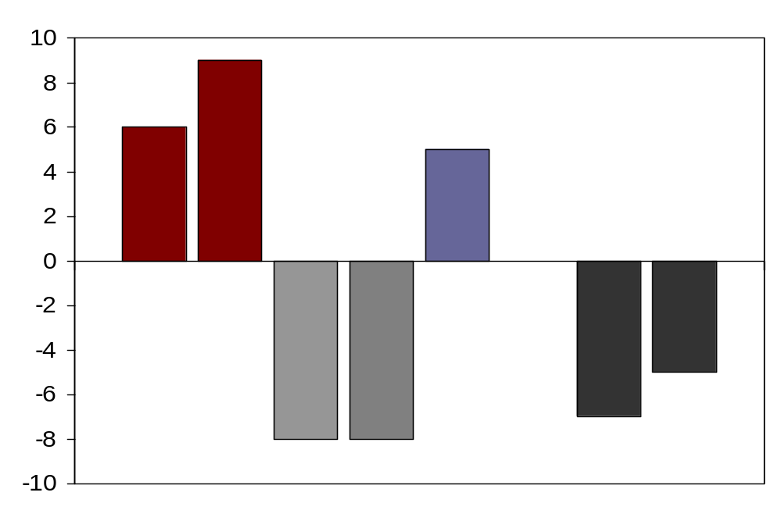
Prioritized SWOTs
Strengths Opportunities
Critical
Need to
Leverage
Need to
Address
Critical
Dealership
network
Identifiable
Target
Good
Economy
Established
Competitors
New Brands
Coming
No Brand
Awareness
Small
Budget
Weaknesses Threats

Slide 14
Situation Analysis
Take an example and discuss SWOT (activity)

Slide 15
Strategy Development
Step 1: Market Segmentation
  Process of identifying a group of people similar in one or more ways, based on a variety of characteristics and behaviors.
  Goal: minimize variance within groups and maximize variance between groups

Slide 16
Identifying Market Segments
“Heavy versus Light” Users – “80/20 rule”
‘Heavy users' are likely to be disproportionately important to the brand (typically, 20 percent of users accounting for 80 percent of usage — and of suppliers' profit).
As a result, suppliers often segment their customers into 'heavy', 'medium' and 'light' users; as far as they can, they target 'heavy users'.

Slide 17
Identifying Market Segments
Demographics: Age, Gender, Income, etc…
Consumer
Characteristics

Slide 18

Consumer Characteristics
Geodemographics
  -- Examine regional differences in demographics
  -- Useful for store location decisions, and direct mailings, and grassroots efforts
    Why?

Slide 19
Identifying Market Segments
Lifestyle & Values
Psychographics/
Benefits

Slide 20
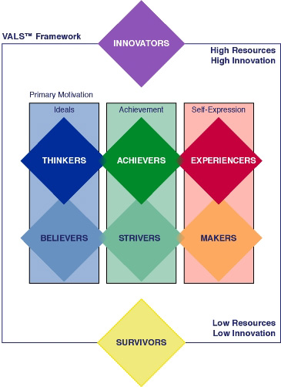
Psychographics
Lifestyle segmentation
VALS is based on primary motivation and resources

Slide 21
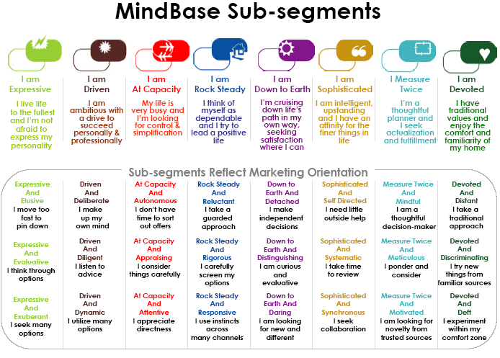
Psychographics

Slide 22
Strategy Development
Step 2: Target Market Selection
  Select segments of the market to offer products and services
  Who can we most efficiently and effectively establish a relationship with better than our competitors?
Notes:
Segment size
Segment growth rate
Competitor strength
Customer satisfaction
Fit with company image/objectives/resources
Distribution availability
Investment required
Stability/predictability
Cost to serve
Sustainable advantage
Communication channels available
Risk
Measurability
Accessibility
Substanitality
Congruity

Slide 23
Customer Profiles
Once a basis for segmentation has been determined and attractive segments have been selected, the target groups should be profiled by describing them on as many levels as possible.

Slide 24
Customer Profile
Age, Education, Income
Occupation, Hobbies
Media Habits
Groups
VAL Segment
Musical Taste, Preferred Cars
Aspirational Role Models

Slide 25
Strategy Development
Step 3: Positioning
  How your product/company is perceived in the hearts and minds of your customers?
    Price leader/Innovator/Fashion leader/ Quality/Service
    What associations come to mind?

Slide 26
Summary
A firm needs to:
  Start by analyzing the market
    5 C’s (Company, Competitors, Collaborators, Customers, and Context)
  Develop a strategic plan
    Begin with Segmentation, Targeting, and Positioning
    Followed by tactical decisions
      Product (Brand), Price, Promotion, and Place
  With a plan in place implementation issues need to be addressed

Slide 27
PEST Analysis

Slide 28
What is PEST Analysis?
It is very important that an organization considers its environment before beginning the marketing process. In fact, environmental analysis should be continuous and feed all aspects of planning. The organization's marketing environment is made up from:
        1. The internal environment
        2. The micro-environment
        3. The macro-environment e.g. Political (and legal) forces, Economic forces, Sociocultural forces, and Technological forces. These are known as PEST factors.

Slide 29
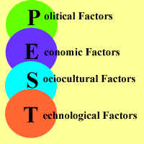

Slide 30
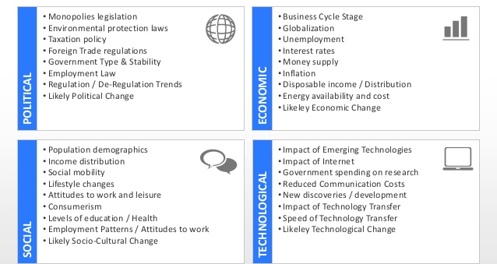
PEST Analysis

